Slide 1
Introduction to Fusion Energy Safety and Regulation
Dr. Patrick White (pwhite@catf.us)
PPPL 2025 Introduction to Plasma and Fusion Course
June 4th, 2025

Slide 2
My personal background: thinking about hard questions at the intersection of technology and policy
Technical Questions
Policy Questions
Stakeholder Communication

Slide 3
CATF Fusion Safety and Regulation Working Group
Goal: Creating a harmonized framework for safety and regulation for commercial fusion energy that can be adopted internationally and enable the global deployment of fusion energy. This framework must include both public acceptance of fusion energy and commercial viability of the technology.
Challenge: Varying regulatory needs throughout based on the specific fusion machine, technology lifecycle, and during different stages of commercialization.
Regulatory Framework
Customers
Developers
Public & NGOs
Regulators
Government
Investors

Slide 4
Fusion energy has immense potential, but safety and regulation must be aligned to enable development
Commercial Fusion Landscape
Fusion Energy Regulation
Other Fusion Considerations

Slide 5
The commercial fusion energy landscape has a wide range of different proposed concepts and technologies
Commercial Fusion Landscape
Fusion Energy Regulation
Other Fusion Considerations

Slide 6
Fusion machines under development use different approaches for commercial energy generations
Confinement Methods
Fusion Reactions
Fusion Fuel Cycles
Power Conversion Cycle
Facility Size

Slide 7
Fusion energy technologies are typically defined based on how they confine the plasma
Magnetic Confinement
Magneto – Inertial Confinement
Inertial Confinement
Alternative Confinement
Includes: Tokamak Stellerator
Includes: Z-Pinch Field Reverse Configuration (FRC)
Includes: Direct ICF Indirect ICF
Includes: Electrostatic Muon Catalyzed

Slide 8
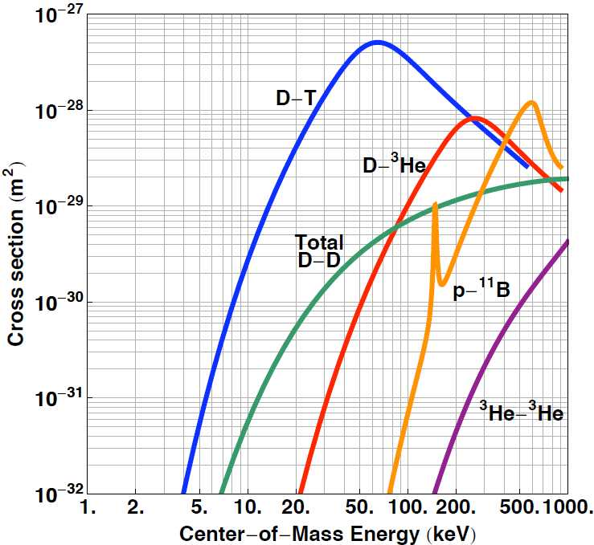
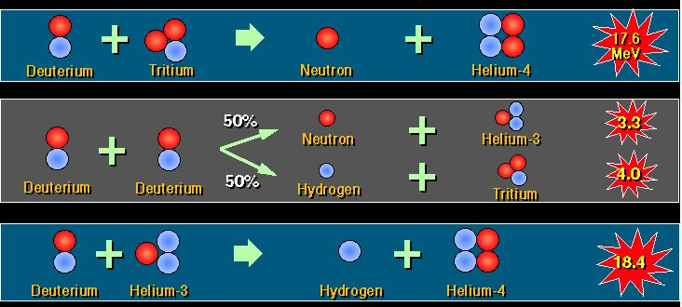
Different fusion fuels will have design and operational advantages and challenges

Slide 9
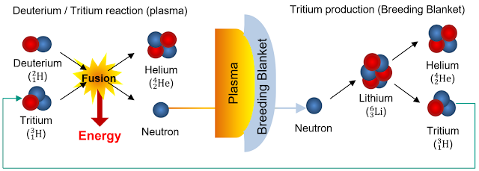
Fusion fuel cycles are needed to produce the specific isotopes required for fusion reactions
Example: Deuterium-Tritium Fuel Production with Lithium-6

Slide 10
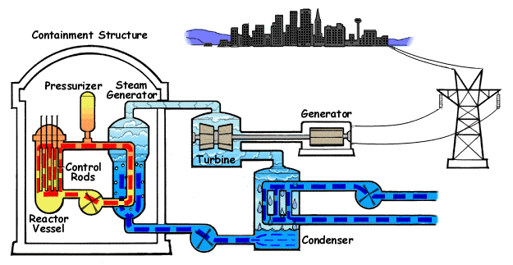
Fusion power conversion cycles may use traditional thermodynamic cycles or novel technologies
Example: Direct Energy Conversion
Example: Steam Rankine Cycle

Slide 11
Private companies are developing machines based on an array of different fusion energy technologies
Confinement Methods
Fusion Reactions
Fusion Fuel Cycles
Power Conversion Cycle
Facility Size

Slide 12
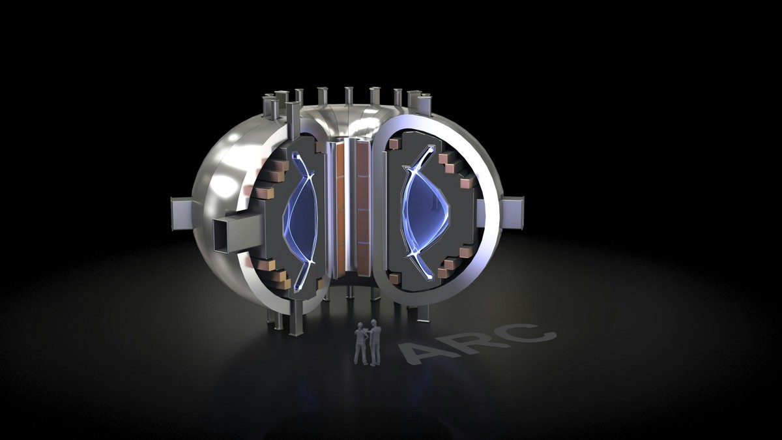
Example: Commonwealth Fusion Systems ($2B+ Private Funding)
Confinement Methods
Magnetic Tokamak
Fusion Reactions
D-T
Fusion Fuel Cycles
FLiBe Blanket Breeding
Power Conversion
FLiBe Blanket to Rankine Cycle
Facility Size
400 MW_{e}

Slide 13
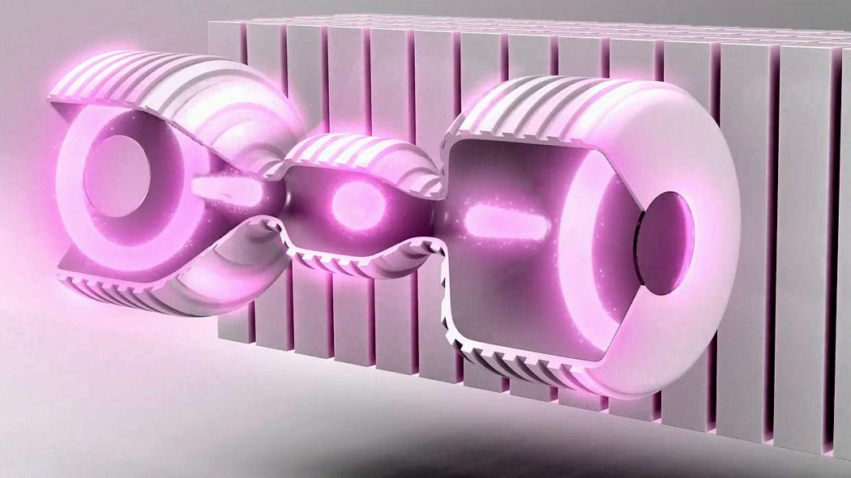
Example: Helion ($1B+ Private Funding)
Confinement Methods
Magneto Inertial
Fusion Reactions
D-³He
Fusion Fuel Cycles
D-D ³He Production, T Decay
Power Conversion
Direct Energy Conversion
Facility Size
50 MW_{e}

Slide 14
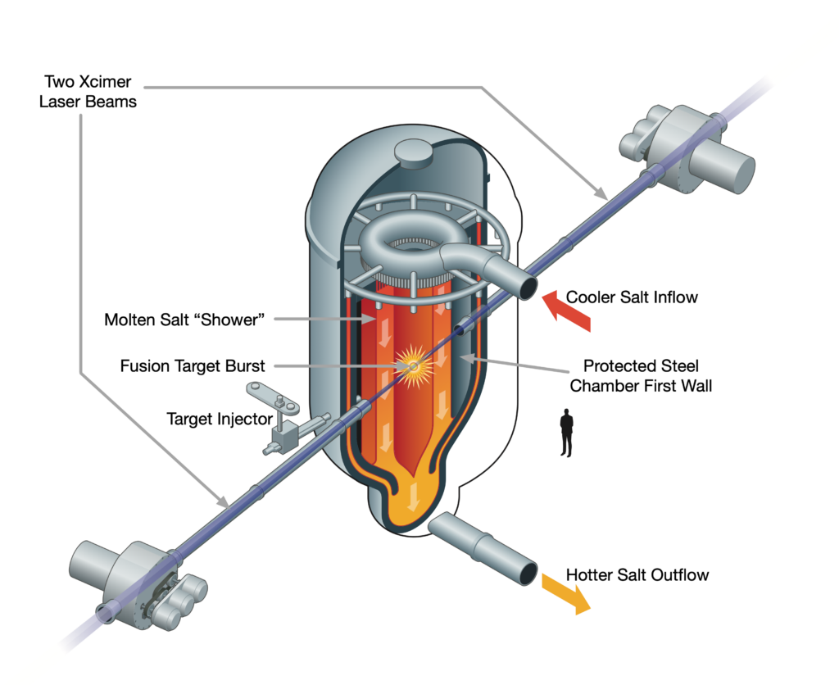
Example: Xcimer ($100M+ Private Funding)
Confinement Methods
Laser Inertial Confinement
Fusion Reactions
D-T
Fusion Fuel Cycles
FLiBe
Power Conversion
FLiBe Blanket to Rankine Cycle
Facility Size
100 MW_{e}

Slide 15
Development of commercial fusion energy will require multiple advances in fusion science and technology
Scientific Demonstration Machines
Engineering Demonstration Machines
Commercial Demonstration Machines
Commercial Machines At Scale
Q_{scientific} >> 1
Q_{engineering} > 1
Cost competitive fusion energy
Q_{scientific} > 1
Q_{engineering} >> 1

Slide 16
Regulation of commercial fusion energy will require efficient and effective licensing of many technologies
Commercial Fusion Landscape
Fusion Energy Regulation
Other Fusion Considerations

Slide 17
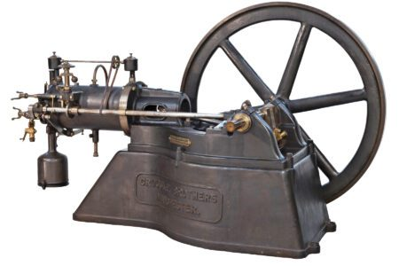
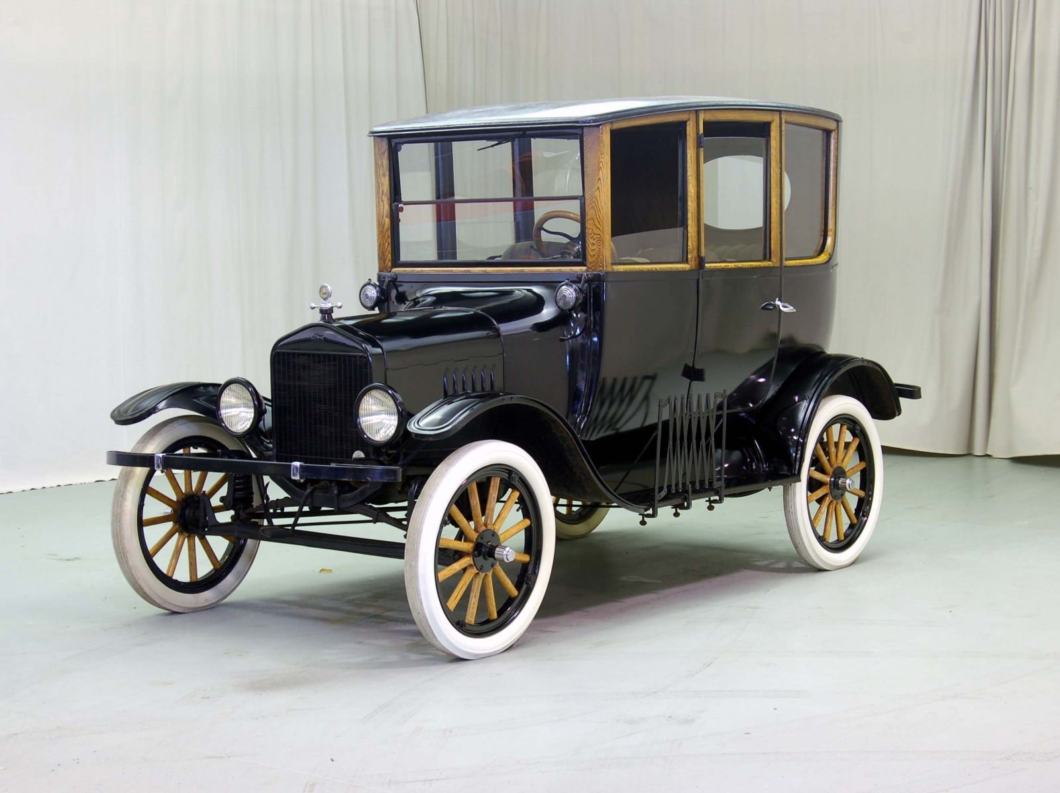
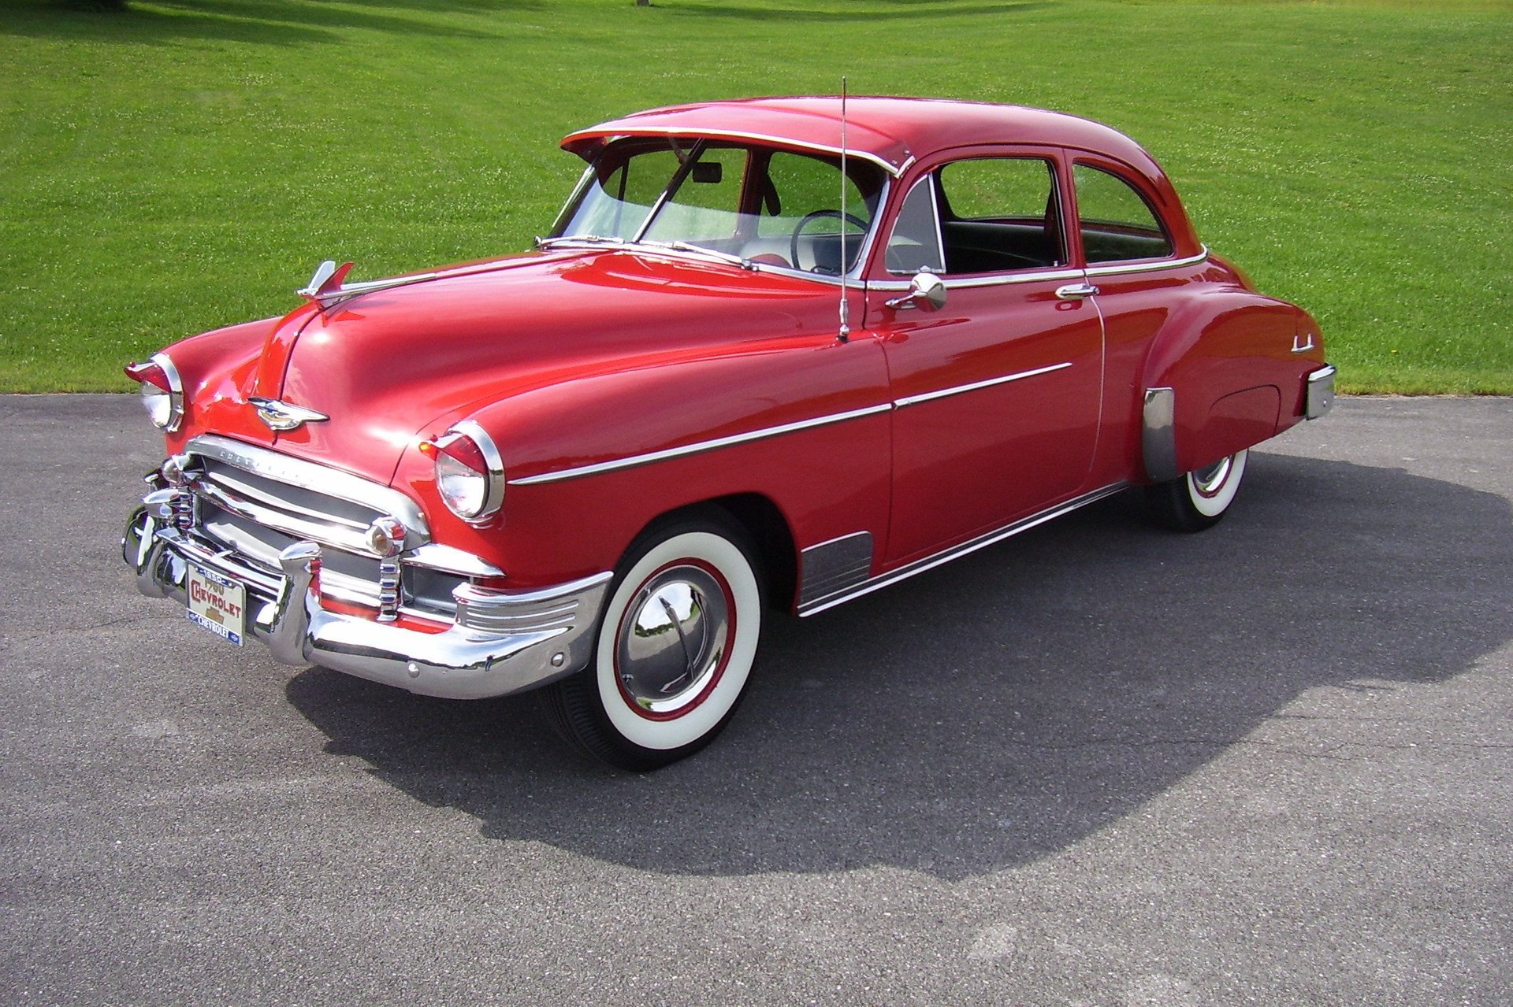
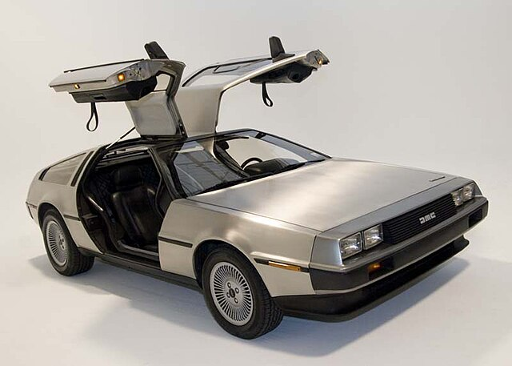
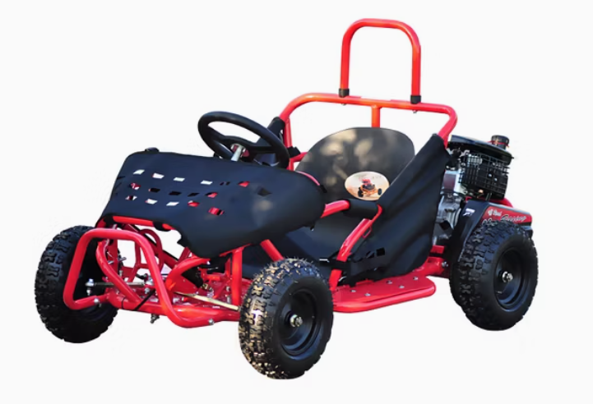
Example: How to regulate every car and engine?
Otto Engine 1876
Ford Model T 1908
Chevy Styleline 1950
DMC Delorean 1981
Honda Civic 2016
Shelby Supercars (SSC) Tuatara 2020
Wiztem Go Kart 2025

Slide 18
Challenges facing fusion machine deployment will evolve during fusion energy development and commercialization
Scientific Demonstration Machines
Engineering Demonstration Machines
Commercial Demonstration Machines
Commercial Machines At Scale
Example: Regulatory needs for fusion will evolve over time based on machines purpose, hazards, experience, and industry maturity

Slide 19
Fusion reactions will have radiological hazards that need to be safely managed
Activated Materials
Tritium
Neutron
Fusion Machine
Example Isotopes of Concern:
³H
¹⁴C
⁵⁹Ni
⁶³Ni
⁶⁰Co
⁹⁴Nb
⁹³Mo
¹⁷⁹Ta
¹⁸²Ta
¹⁸³Ta
¹⁸⁴Re
¹⁸⁶Re
¹⁸⁷W
¹⁸⁵W
Deuterium
Helium

Slide 20
Commercial deployment of fusion energy will requirement management of fusion hazards
Example Radiological Hazards
Example Industrial Hazards
Neutron Activation
Material Contamination
Cryogenic Systems
Magnetic Fields
Direct Radiation Exposure
Tritium
Toxic Materials
Stored Energy and Materials

Slide 21
Diversity of technical approaches and design maturity makes regulation of commercial fusion challenging
Example: Regulating tritium hazards
Potential fusion machine safety analyses could vary by factor of more than 10,000,000 based on machine-specific technology, design, and analysis choices!
EU DEMO?
10,000 gram
ITER?
1,000 gram
Commercial Machine?
100 gram
Hazard release conditions and exposure scenarios can change doses by more than a factor of 100,000
Test Machine?
10 gram
R&D Facility?
1 gram
University Lab?
0.1 gram
Total Tritium Inventory

Slide 22
Fusion regulation in the United States is currently under development by NRC and agreement states
2009
NRC Commission asserts regulatory jurisdiction on fusion energy
2020
Commission directs NRC staff to develop new options for licensing fusion energy
1980s – 1990s
DOE regulation
PPPL TFTR
1990s
DOE development of ITER relevant safety guidance
2019
NEIMA defines fusion as advanced nuclear and directs rulemaking
2020 – January 2023
NRC staff develop options paper for Commission on fusion licensing

Slide 23
NRC staff developed three different options for the near-term regulation of commercial fusion energy
Recommended by Staff
Regulate fusion energy systems under a utilization facility framework
Regulate fusion energy systems under a byproduct material framework
Regulate fusion energy systems under a hybrid framework based on potential hazards
Option 1
10 CFR Part 50
Option 2
10 CFR Part 30
Option 3
10 CFR Part 30 for low hazards
10 CFR Part 50 for high hazards

Slide 24
Fusion regulation in the United States is currently under development by NRC and agreement states
2009
NRC Commission asserts regulatory jurisdiction on fusion energy
2020
Commission directs NRC staff to develop new options for licensing fusion energy
April 2023
Commission votes to license near-term fusion energy using 10 CFR Part 30
1980s – 1990s
DOE regulation
PPPL TFTR
1990s
DOE development of ITER relevant safety guidance
2019
NEIMA defines fusion as advanced nuclear and directs rulemaking
2020 – January 2023
NRC staff develop options paper for Commission on fusion licensing

Slide 25
Commission voted to regulate fusion using the byproduct materials framework for near-term licensing
Limited Scope Rulemaking on Fusion Energy Definitions
Development of Guidance for Fusion Energy in NUREG-1556 Volume 22
Staff Implementation Actions
Regulate fusion energy systems under a byproduct material framework
Engagement with NRC Agreement States on Fusion Energy Regulation
Option 2
10 CFR Part 30

Slide 26
Fusion regulation in the United States is currently under development by NRC and agreement states
2009
NRC Commission asserts regulatory jurisdiction on fusion energy
2020
Commission directs NRC staff to develop new options for licensing fusion energy
April 2023
Commission votes to license near-term fusion energy using 10 CFR Part 30
1980s – 1990s
DOE regulation
PPPL TFTR
1990s
DOE development of ITER relevant safety guidance
2019
NEIMA defines fusion as advanced nuclear and directs rulemaking
2020 – January 2023
NRC staff develop options paper for Commission on fusion licensing
December 2024
NRC staff submit proposed fusion energy regulation rule to Commission

Slide 27
Proportional, technology-inclusive, and performance-based regulation enable effective, scalable fusion licensing
Technology-Inclusive Requirements
Applies to any proposed fusion machine
Lowers barriers to fusion technology innovation
Performance-Based Requirements
Utilizes quantifiable health and safety licensing criteria
Enables demonstration of multiple approaches to fusion safety
Proportional Licensing Requirements
Scales reviews based on the specific level of hazards in application
Ensures safety while reducing opportunities for over-regulation

Slide 28
Proportional licensing requirements enable regulations to scale based on the specific application
Example: Regulating tritium hazards
Documentation of Licensing Safety Case
EU DEMO?
10,000 gram
Licensing Analysis of Machine Safety
ITER?
1,000 gram
Commercial Machine?
Engineered Safety Systems and Operational Safety Programs
100 gram
Test Machine?
10 gram
Off-site Emergency Planning and Response Requirements
R&D Facility?
1 gram
University Lab?
Environmental Impact Review and Siting Requirements
0.1 gram
Total Tritium Inventory

Slide 29
Consensus on fusion regulatory principles and national implementation creates pathways for fusion deployment
Technology-Inclusive Requirements
Scientific Demonstration Machines
Engineering Demonstration Machines
Commercial Demonstration Machines
Commercial Machines At Scale
Performance-Based Requirements
Proportional Licensing Requirements
Certainty
Predictability and Flexibility
Scalability

Slide 30
Widescale deployment of fusion energy must also consider byproduct and non-proliferation questions
Commercial Fusion Landscape
Fusion Energy Regulation
Other Fusion Considerations

Slide 31
Fusion machines will produce varying activated and contaminated materials based on design and operation
Activated Structural Materials
Tritiated Contaminated Materials
Other Radioactive Contaminated Materials
Radioactive material production will depend on fusion neutron energy, flux, and fluence; material selection and material impurities; operational time…

Slide 32
Successful deployment of fusion energy should include management of byproducts from a commercial lifecycle
Sustainable FPPs by Design
FPP Lifecycle Characterization
FPP Waste Characterization
Sustainability Strategies for FPP
FPP Lifecycle Management
Reduce
Storage
FPP
Construction
Reduce by Design and Operation
Reduce Waste Quantity/Volume
On-site or In-situ Storage
Consolidated Storage
On-going Wastes
Reduce by Post-Processing
Reduce Waste Hazards
FPP Operation
Transportation
FPP Design Process
Periodic Wastes
Existing Infrastructure
New Infrastructure
Reuse
FPP Maintenance
Direct Material Reuse
Material Refurbishment
One-time Wastes
Disposal
FPP Decomm.
Effluent Release
Hazardous Waste Disposal
Recycle
Recycle for FPP Use
Recycle for Industrial Use
Industrial Waste Disposal
Radiological Waste Disposal
Waste Quantity and Volume
Waste Physical Characteristics
Waste Hazards (Rad., Chem., Bio.)

Slide 33
Evaluation of existing export controls and systems is needed to assess impact of fusion energy on proliferation
High energy and high fluence neutron source
Sensitive dual-use materials
Sensitive dual-use technology
Sensitive dual-use knowledge
Production of special nuclear material
Tritium, enriched lithium
Lithium isotope separation, high energy and high fluence neutron generators
Inertial confinement fusion data

Slide 34
Fusion energy has immense potential, but safety and regulation can be aligned to enable deployment
Commercial Fusion Landscape
Fusion Energy Regulation
Other Fusion Considerations

